Slide 1
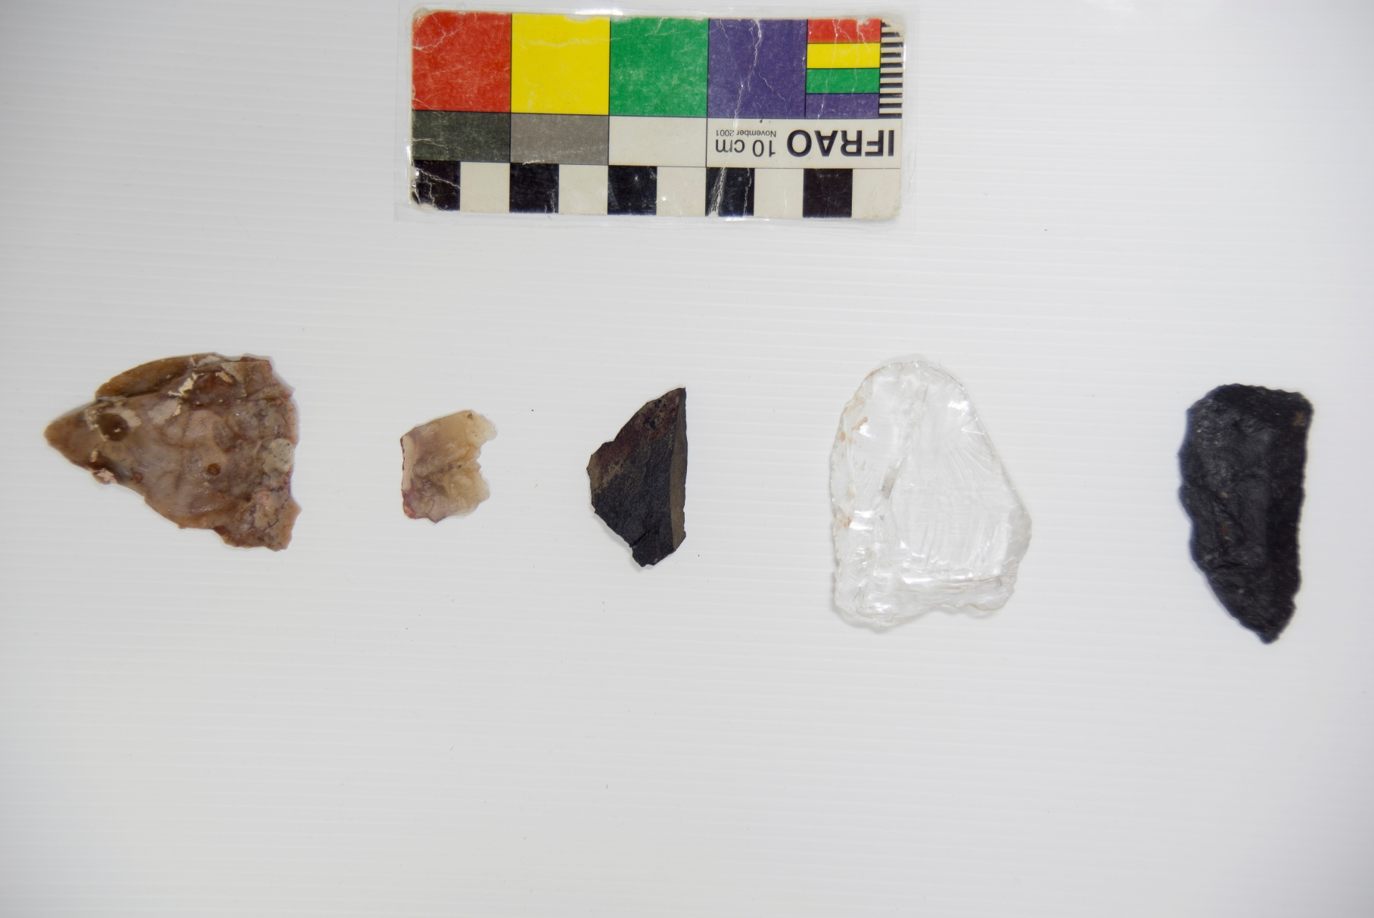
Positive control samples: the 2 and 3 counting from left to right, they have human blood and the rest were used to cut beef with one of its edges.

Slide 2
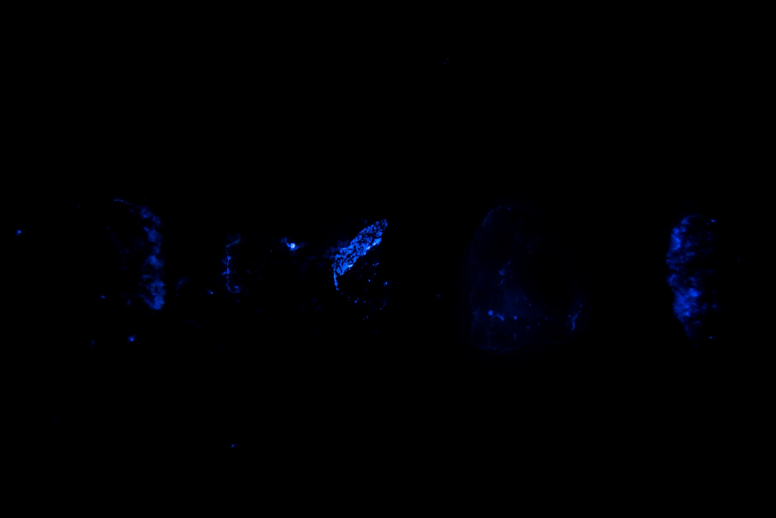
Positive control samples: the 2 and 3 counting from left to right, they have human blood and the rest were used to cut beef with one of its edges. In darkness.

Slide 3
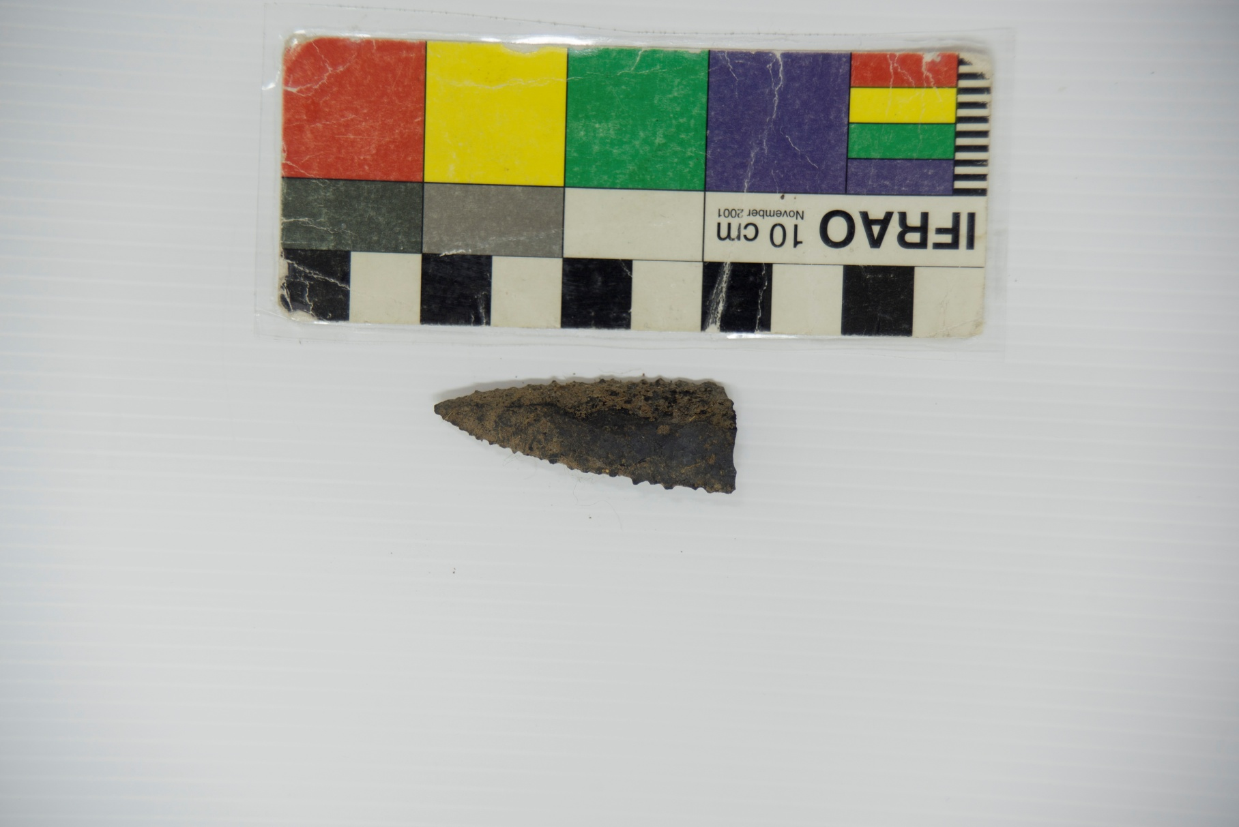
Sample PCz 1.2 C1 (3) (3) No. 154: with artificial light.

Slide 4
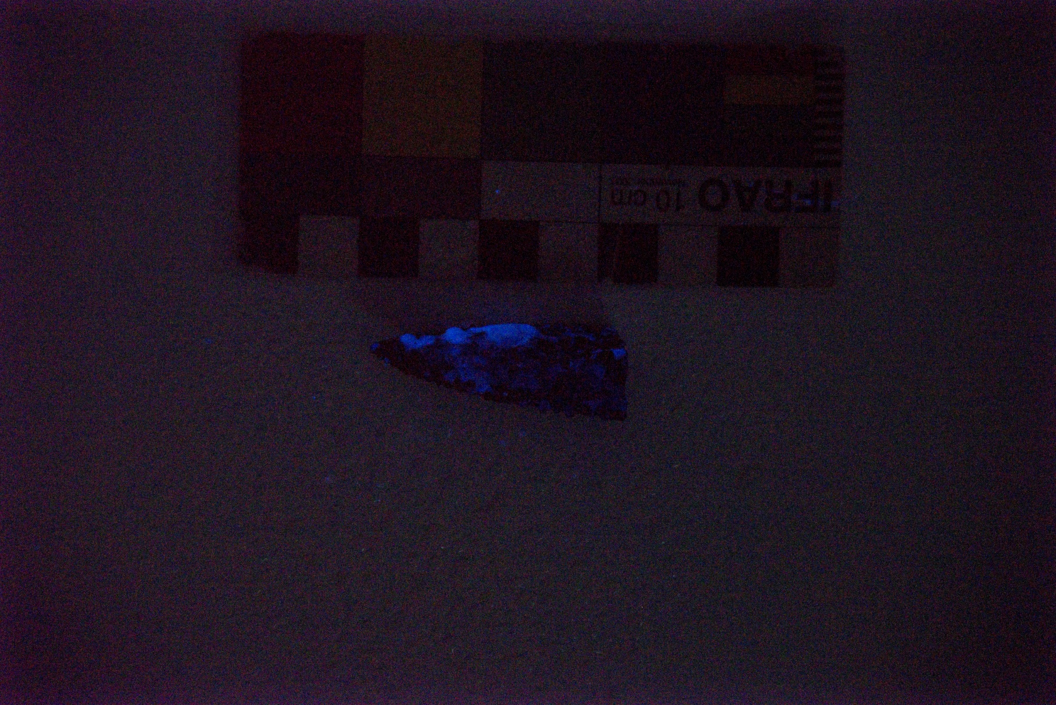
Sample PCz 1.2 C1 (3) (3) No. 154: In darkness.

Slide 5
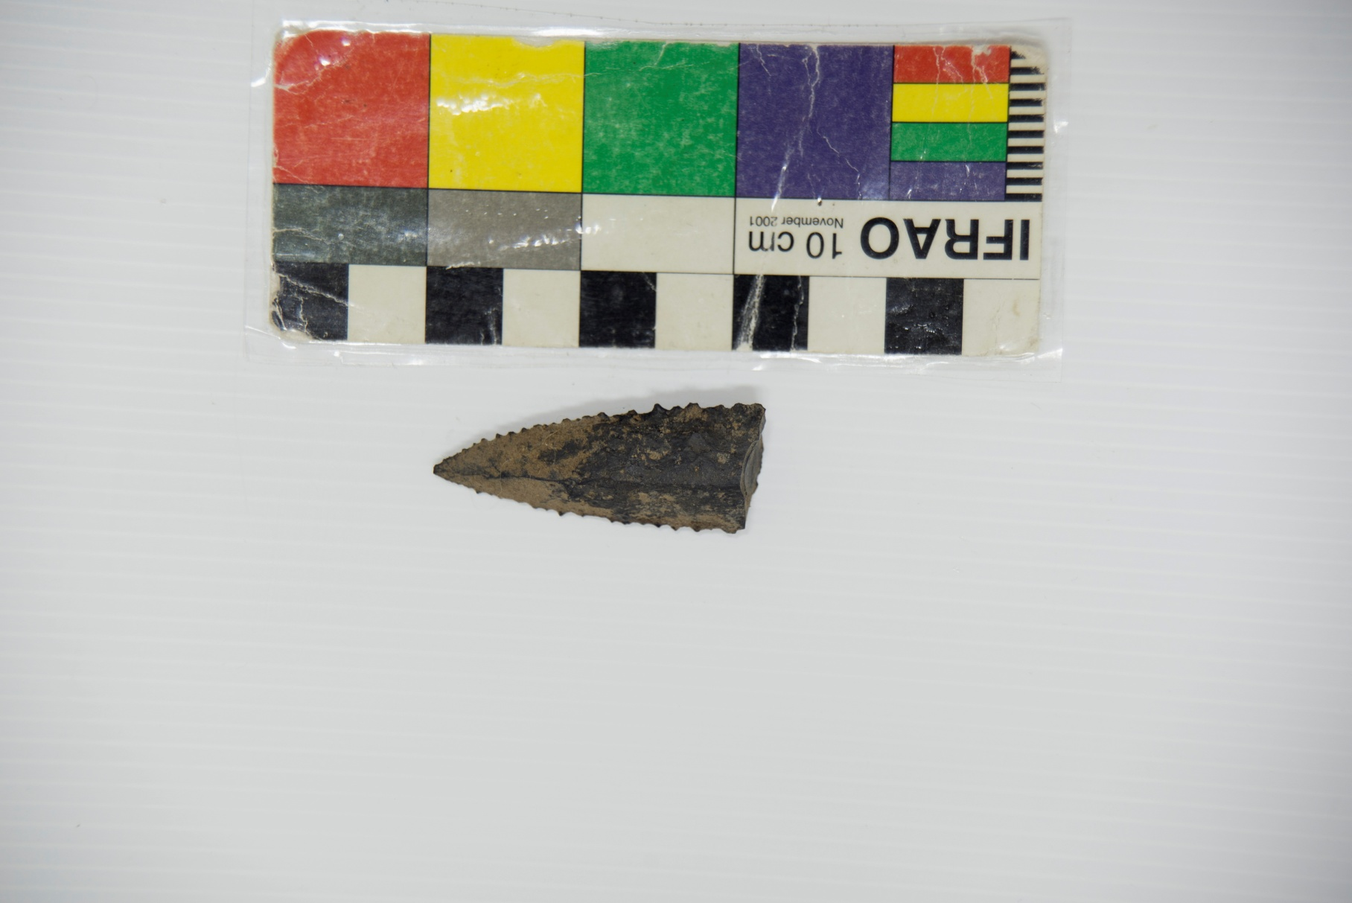
Sample PCz 1.2 C1 (3) (3) No. 154: with artificial light.

Slide 6
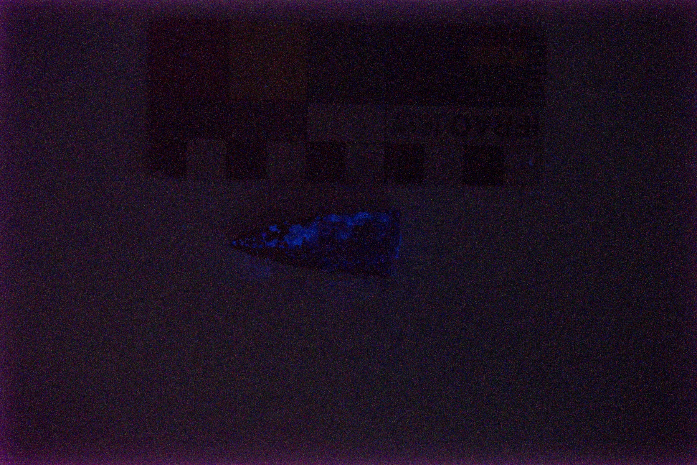
Sample PCz 1.2 C1 (3) (3) No. 154: In darkness.

Slide 7
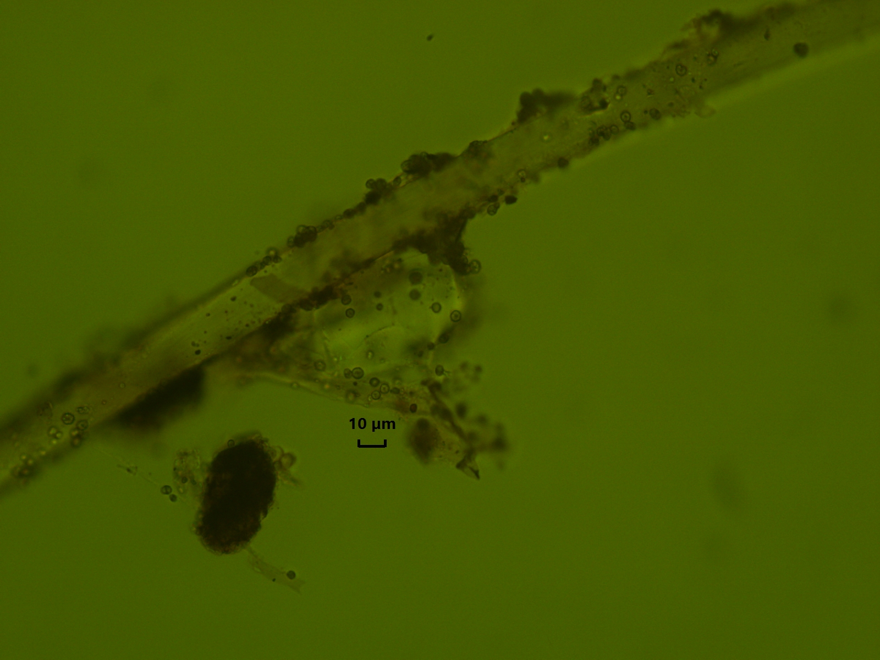
Sample PCz 1.2 C1 (3) (3) No. 154: Fiber of attached camelid seen at an optical microscope at 400 magnifications. possible Erythrocyte.

Slide 8
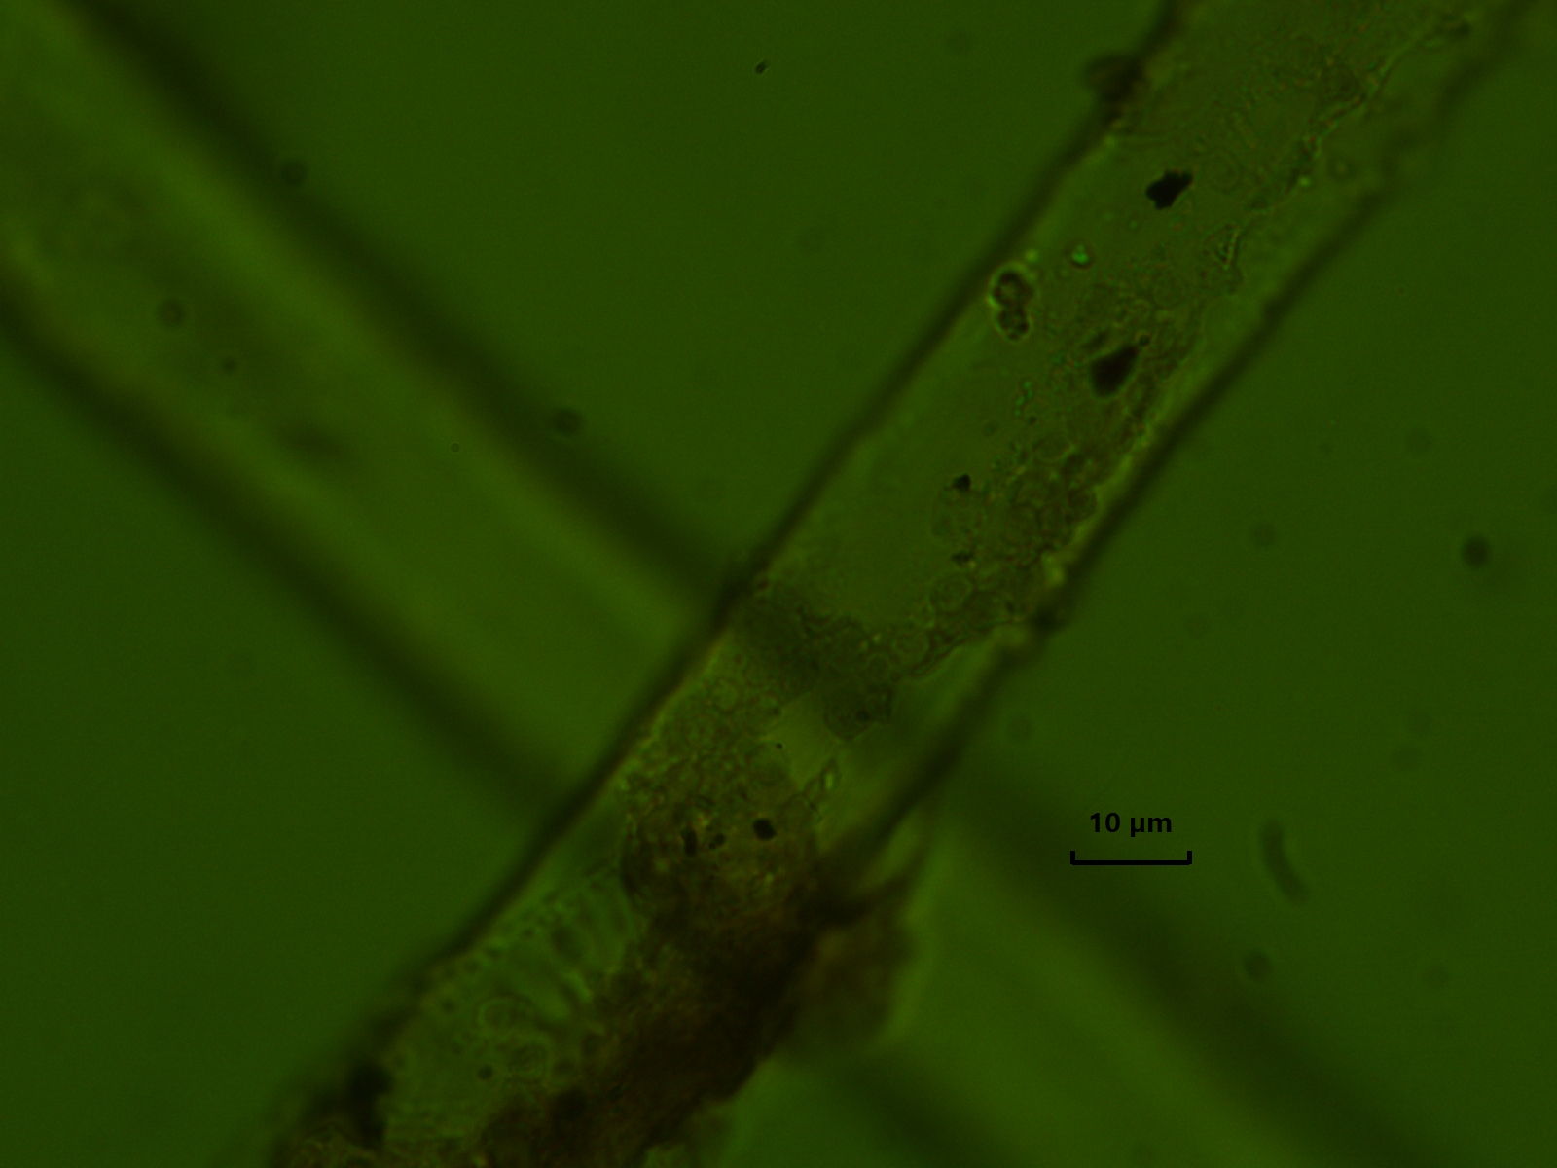
Sample PCz 1.2 C1 (3) (3) No. 154: Fiber of attached camelid seen at an optical microscope at 1000 magnifications. Possible Erythrocyte.

Slide 9
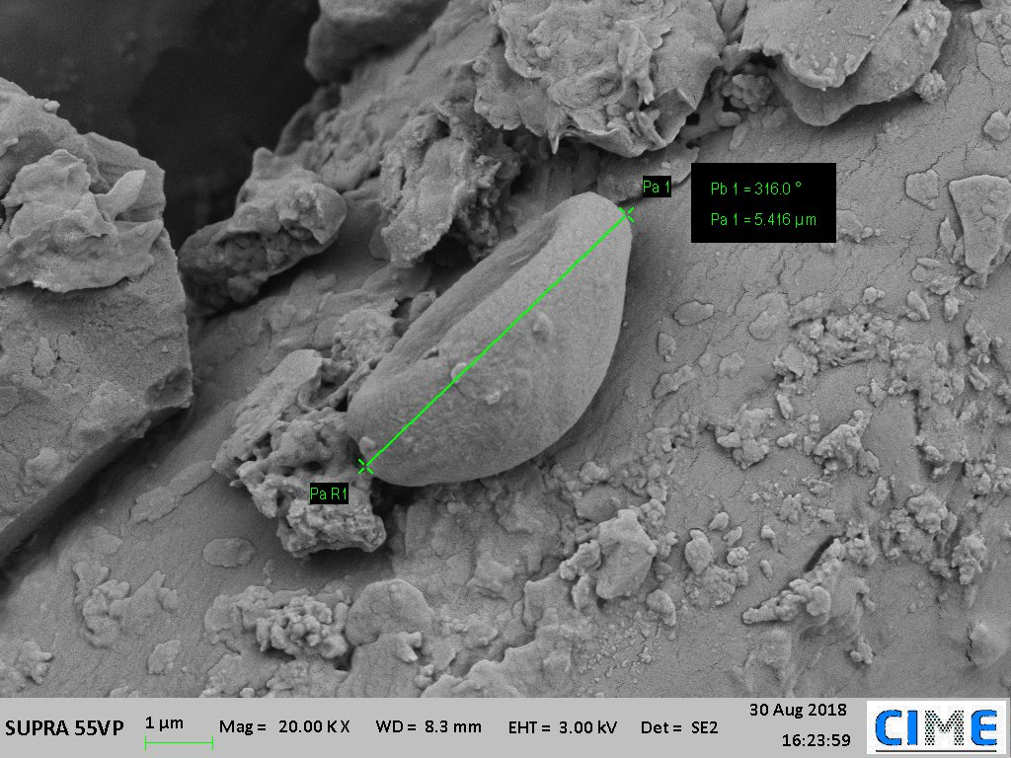
Sample PCz 1.2 C1 (3) (3) No. 154: Erythrocyte image taken with scanning electron microscope SEM. 20000 increases.

Slide 10
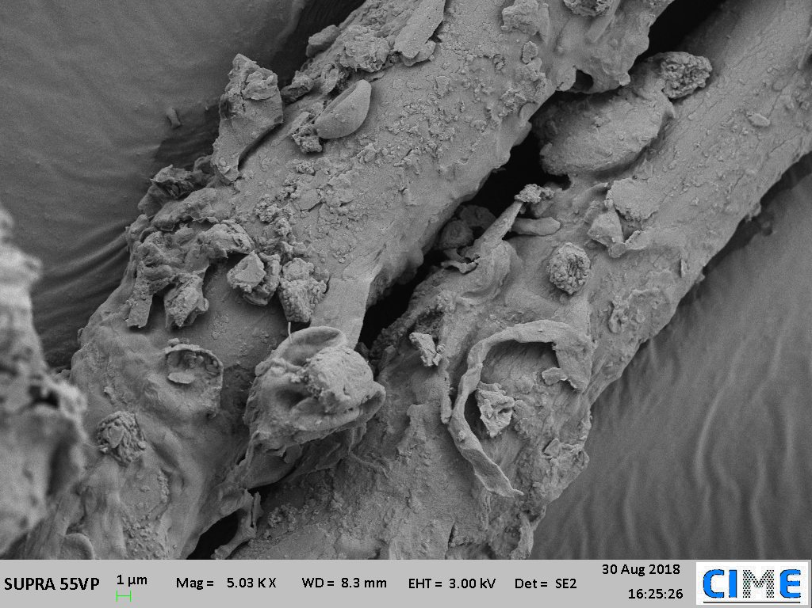
Sample PCz 1.2 C1 (3) (3) No. 154: Black arrow: set of erythrocytes; Red arrow: possible leukocyte. image taken with scanning electron microscope SEM. 5000 increases

